Slide 1

Week 2 – Dimensions of Wellness & SDOH

Slide 2

Today’s Agenda
The 7 Dimensions of Wellness
Social Determinants of Health (SDOH)
Learning Activity - counts towards your Learning Activity Grades

Slide 3
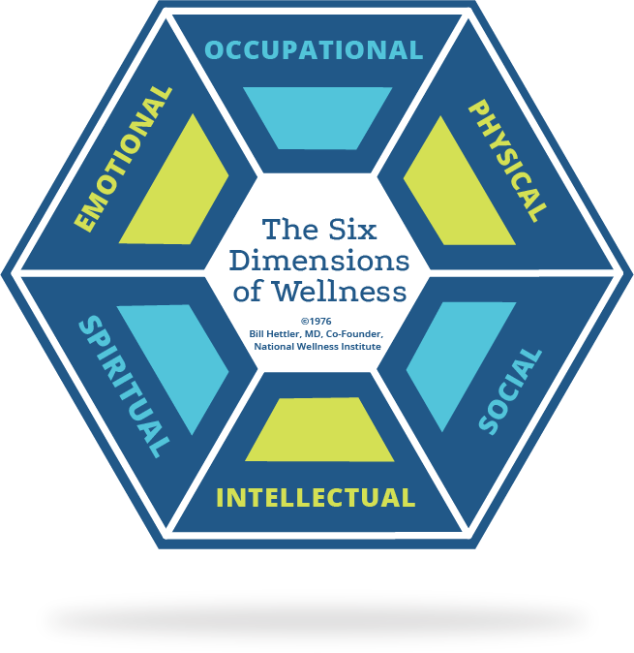
Six Dimensions of Wellness
Developed by Dr. Bill Hettler in the 1970’s

Slide 4

Social Dimension
Collectivist view of the world
Contribute to society
Help others
Seek ways to enhance relationships, build healthy communities

Slide 5

Occupational Dimension
Enrichment through work or vocation
Work is meaningful and rewarding
Balance of work and life commitments
Occupation consistent with personal values, interests and beliefs

Slide 6

Spiritual Dimension
Identifying our basic purpose in life
Learning how to experience love, joy, peace, fulfillment
Helping ourselves and others achieve our potential
Can mean a connection to a formal religion or faith

Slide 7

Physical Dimension
Participating in regular physical activity
Making healthy food choices
Avoiding harmful behaviours
Seeking medical attention when needed
Pursuing physical wellness may heighten awareness of the mind-body-spirit connection

Slide 8

Intellectual Dimension
Ability to think and learn from life experience
Openness to new ideas
Capacity to question and evaluate information
Cherishing intellectual growth and stimulation

Slide 9

Emotional Dimension
Feeling positive and enthusiastic
Awareness and acceptance of feelings in oneself and others
Capacity to express and manage feelings
Ability to cope with stressors
Can recognize when help is needed

Slide 10

The 7th Dimension: Environmental Dimension
Difficult to adopt a ‘well’ way of living when our environment is not healthy and well
Being respectful and attempting to live in harmony with nature
Ensuring stability and longevity of natural resources

Slide 11
Social Determinants of Health
Health is determined by complex interactions between our environment, genetic makeup, and where we live and work
Can you think of things
in life that affect your
personal health?

Slide 12

SDOH – Defined
“The economic and social conditions that shape the health of individuals, communities, and jurisdictions as a whole … and the primary determinants of whether individuals stay healthy or become ill”
The larger the gap, the lower the health status

Slide 13



Social Determinants of Health
Disability
Early life
Education
Employment and working conditions
Food security
Notes:
Disability: low compensation and benefits to disabled Canadians. Bill C-81, the Accessible Canada Act: An Act to Ensure a Barrier-free Canada, to help improve accessibility for all Canadians
Early life: Developmental vulnerability – skills and behaviours are lower compared to peers, often live in disadvantaged conditions e.g. living in poverty, lack of access to nutritious food, inadequate housing, lack of safe childcare. Social location (class, race, gender, immigrant status) can influence overall health
Education: Higher education = better health and access to job training and opportunity for gainful employment
Employment and working conditions: Working hours, work stress, rewarding/enjoying opportunities
Food insecurity: 11.9% of Canadian households experience food insecurity; psychological impacts on families dealing with food insecurity are linked to behavioural, emotional, and academic problems

Slide 14
Disability: low compensation and benefits to disabled Canadians. Bill C-81, the Accessible Canada Act: An Act to Ensure a Barrier-free Canada, to help improve accessibility for all Canadians
Early life: Developmental vulnerability – skills and behaviours are lower compared to peers, often live in disadvantaged conditions e.g. living in poverty, lack of access to nutritious food, inadequate housing, lack of safe childcare. Social location (class, race, gender, immigrant status) can influence overall health
Education: Higher education = better health and access to job training and opportunity for gainful employment
Employment and working conditions: Working hours, work stress, rewarding/enjoying opportunities
Food insecurity: 11.9% of Canadian households experience food insecurity; psychological impacts on families dealing with food insecurity are linked to behavioural, emotional, and academic problems

Slide 15
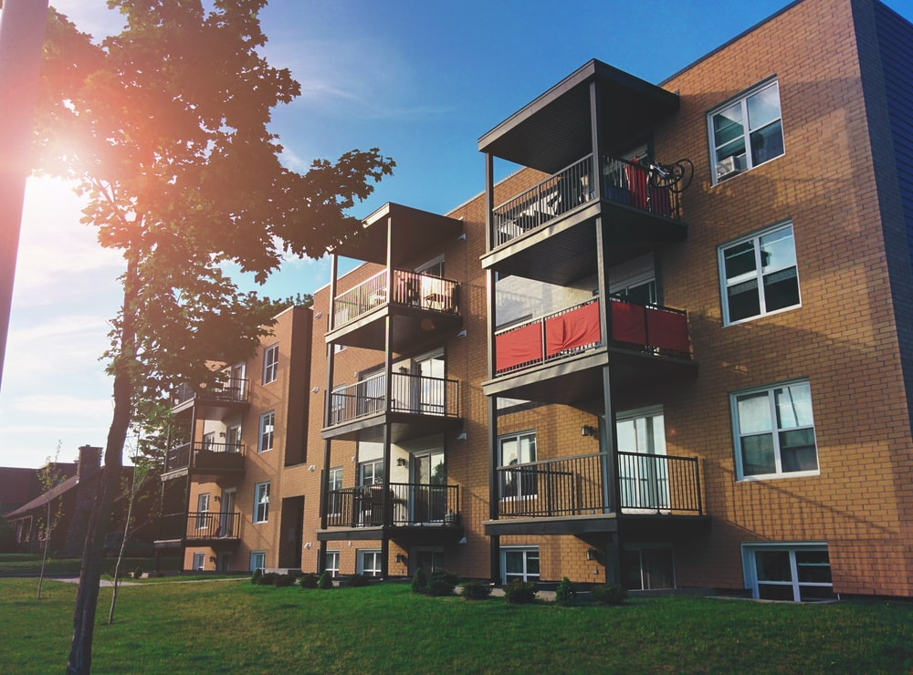

Social Determinants of Health (cont.)
Gender
Geography
Health care services
Housing
Immigrant status
Notes:
Gender: increased risk of poor health for women, discrimination against LGBTQ2+
Geography: rural/northern are more disadvantaged, living in segregated or near hazardous neighbourhoods
Healthcare services: public healthcare insurance but access issues for rural, low-income wait times
Housing: high rents, under-housed or homeless are at greater risk of health issues
Immigrant status: sometimes marginalized, difficult to access health, social, and education services, lower paying jobs, family separation

Slide 16
Gender: increased risk of poor health for women, discrimination against LGBTQ2+
Geography: rural/northern are more disadvantaged, living in segregated or near hazardous neighbourhoods
Healthcare services: public healthcare insurance but access issues for rural, low-income wait times
Housing: high rents, under-housed or homeless are at greater risk of health issues
Immigrant status: sometimes marginalized, difficult to access health, social, and education services, lower paying jobs, family separation

Slide 17

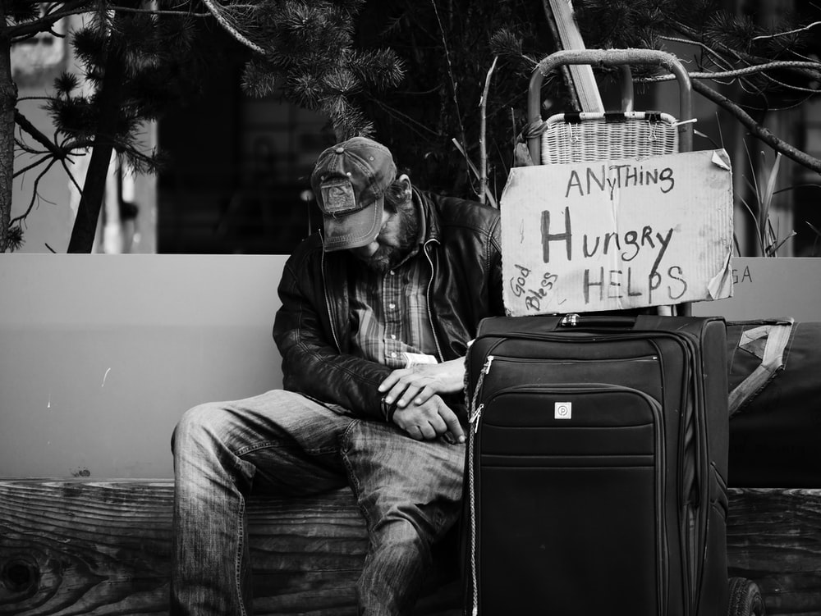
Social Determinants of Health (cont.)
Income and its distribution
Indigenous ancestry
Race
Social exclusion
Social safety net
Unemployment and employment security
Notes:
Income and its distribution: Low income predisposes people to greater social deprivations (inability to afford basic food, clothing, housing)
Indigenous ancestry: 4.9% (in 2016) of population are Indigenous (First Nation, Inuit, Métis), up 3.8% from 2006, more than 4 times rest of Canadian population. Emotional, physical and sexual abuse are more common due to social exclusion, institutional racism and colonialism. Truth and Reconciliation: Calls to Action report to begin process of reconciliation and decolonization.
Race: Immigrants, racialized groups (LGBTQ2+, Indigenous) may experience racism. Canadians of colour experience higher unemployment, racial profiling, health deterioration of recent immigrants and refugees
Social exclusion: lack of opportunities to participate and contribute to social and cultural activities
Social safety net: programs, services, and benefits to assist individuals/families
Unemployment and Employment security: changes in workforce related to globalization;
unemployment increases the likelihood of choosing unhealthy lifestyle choices (i.e., smoking, alcohol misuse)

Slide 18
Income and its distribution: Low income predisposes people to greater social deprivations (inability to afford basic food, clothing, housing)
Indigenous ancestry: 4.9% (in 2016) of population are Indigenous (First Nation, Inuit, Métis), up 3.8% from 2006, more than 4 times rest of Canadian population. Emotional, physical and sexual abuse are more common due to social exclusion, institutional racism and colonialism. Truth and Reconciliation: Calls to Action report to begin process of reconciliation and decolonization.
Race: Immigrants, racialized groups (LGBTQ2+, Indigenous) may experience racism. Canadians of colour experience higher unemployment, racial profiling, health deterioration of recent immigrants and refugees
Social exclusion: lack of opportunities to participate and contribute to social and cultural activities
Social safety net: programs, services, and benefits to assist individuals/families
Unemployment and Employment security: changes in workforce related to globalization;
unemployment increases the likelihood of choosing unhealthy lifestyle choices (i.e., smoking, alcohol misuse)

Slide 19
Think-Pair-Share
Consider this case study:
“Susan has travelled across Canada to attend university 1000km away from home. She is finding the transition from high school to university more challenging than she thought. Connecting with new friends has been difficult. Money management is proving to be complex. The academic demands are surprising. She is no longer playing organized school sports and has yet to find her way to the campus athletic center. She knows she needs to change so that she can begin to enjoy this new adventure.”
Which Social Determinants of Health are having an affect on Susan? Why?
Think about this.
Notes:
Possible answers – geography, income and its distribution, social safety net

Slide 20
Possible answers –
Geography, income and its distribution, social safety net

Slide 21
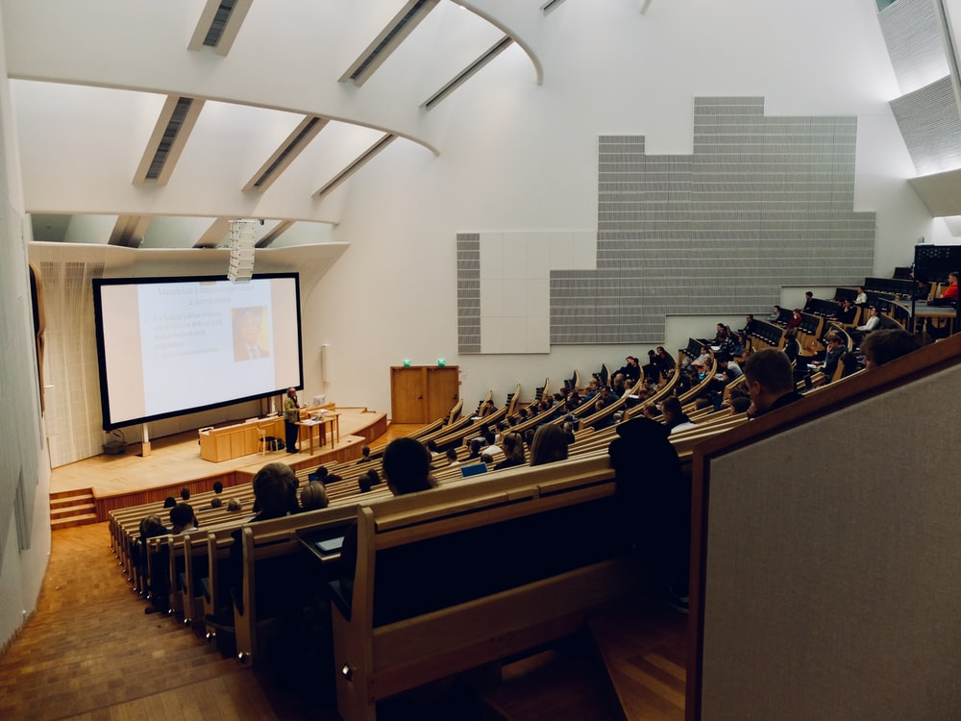
The Health of College and University Students
Engaging in some behaviours increases risk for serious health problems
More distress reported compared to the general Canadian population
Many risk factors for disease decline as education increases
Notes:
College-age men are more likely than women to engage in risk-taking behaviours (i.e., drug and alcohol use, risky sexual behaviour, and dangerous driving)
Nearly one-third of undergraduate students surveyed had significantly elevated psychological distress

Slide 22
Understanding Health Behaviour
Behaviours that affect your health
Exercising regularly
Eating a balanced nutritious diet
Seeking care for symptoms
Taking the necessary steps to overcome illness and restore well-being
40–80% who try to change a bad health habit lapse within six weeks
Notes:
To make lasting changes, it is important to understand factors that shape behaviour

Slide 23
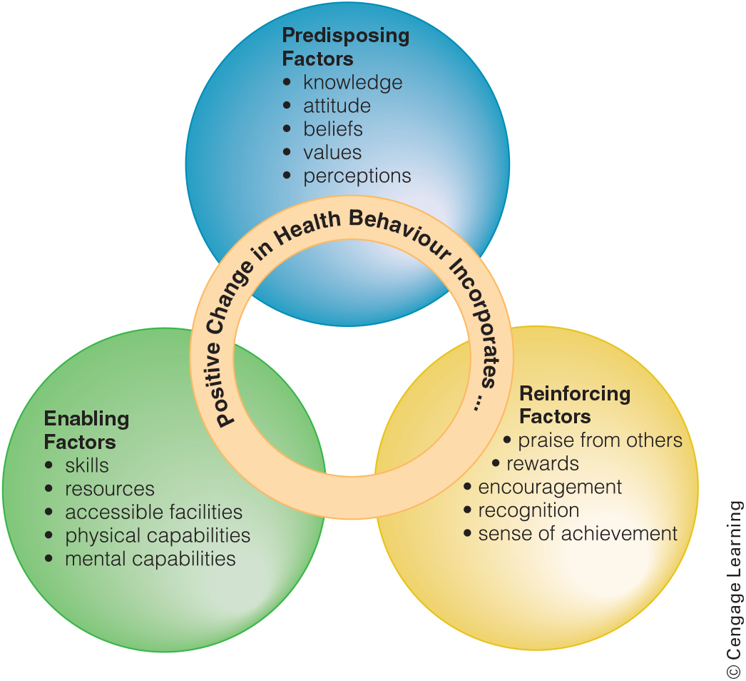
Factors That Shape Positive Behaviour
Figure 1-7 Factors That Shape Positive Behaviour

Slide 24

Predisposing Factors
Encourage or inhibit a behaviour change
Include knowledge, attitudes, beliefs, values, self-efficacy, behavioural intentions, and existing skills
Affected by age, sex, socio-economic level, ethnicity, family background, healthcare access, and level of education

Slide 25

Enabling Factors
Make it possible or easier for people or populations to change their behaviours
Positive: individual physical and mental capacities, resources, living conditions, societal support, accessible facilities, programs, and services and developing skills
Negative: people who encourage you to choose unhealthy lifestyle options or health services that don’t have your best interests at heart

Slide 26

Reinforcing Factors
Include:
Praise from family and friends
Rewards from teachers or parents
Encouragement and recognition for meeting a goal
Healthy community policies
Notes:
Lasting change also depends on internal commitment and sense of achievement

Slide 27

Decision Making
Set priorities
Inform yourself
Consider all your options
Tune in to your intuitive feelings
Consider a worst-case scenario
Notes:
Small or large decisions can be broken down into manageable steps:
Ask yourself “What would you like to accomplish?”
Gather information
List advantages and disadvantages of options
If something doesn’t feel right, listen
If you can live with the consequence, it’s probably the right choice

Slide 28
Healthy Behaviour Change
So now that we know what Health & Wellness is, and we know about SDOH, how can we make healthy behaviour changes?

Slide 29
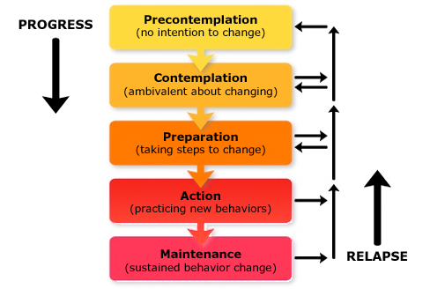
Stages of Change: Where do you fit in?
One of the most well recognized models:
Trans-theoretical model of change developed in the 1980’s
The idea that individuals tend to progress through a sequence of stages as they make behaviour changes
New exercisers are likely to stop during the first 3-6 months & relapse back to old habits/ways

Slide 30

Successful Change
Some people find it helpful to sign a “contract”
Change also depends on the belief that you can and will succeed (self-efficacy)
Another crucial factor is locus of control:
If you believe that your actions will make a difference in your health, your locus of control is internal
If you believe that external forces or factors play a greater role, your locus of control is external
Reinforcements (either positive or negative) can also play a role
Self-talk, the messages you send yourself, can also play a role in change

Slide 31

In-Class Journal #1 (2.5%):Personal Reflection
Think about the following question:
How do you currently contribute to the dimensions of wellness to ensure your personal well-being? Which dimension of wellness do you believe is the most “fulfilled” for you personally?
Answer this question in a journal entry on Blackboard. You will find the journal in the Week 2 learning content.

Slide 32

Next Week:
Stress
Time Management
Mindfulness
Information about Quiz #1 (5%)

